Slide 1


GROCERY STORE MANAGEMENT

Slide 2
TEAM MEMBERS
Herold Hercules - Swanthana

Slide 3
Objectives
The main goals of this SQL project are:
To design and implement a relational database for a grocery store that organizes data related to customers, products, suppliers, employees, and orders.
To retrieve, manage, and manipulate data using SQL queries to support daily operations and reporting needs.
To analyze sales data to generate business insights such as identifying top customers, high-performing products, and revenue patterns.
To evaluate operational performance by examining trends in orders, supplier contributions, and employee activities.
To ensure data integrity and consistency through the use of primary keys, foreign keys, and well-defined relationships.

Slide 4
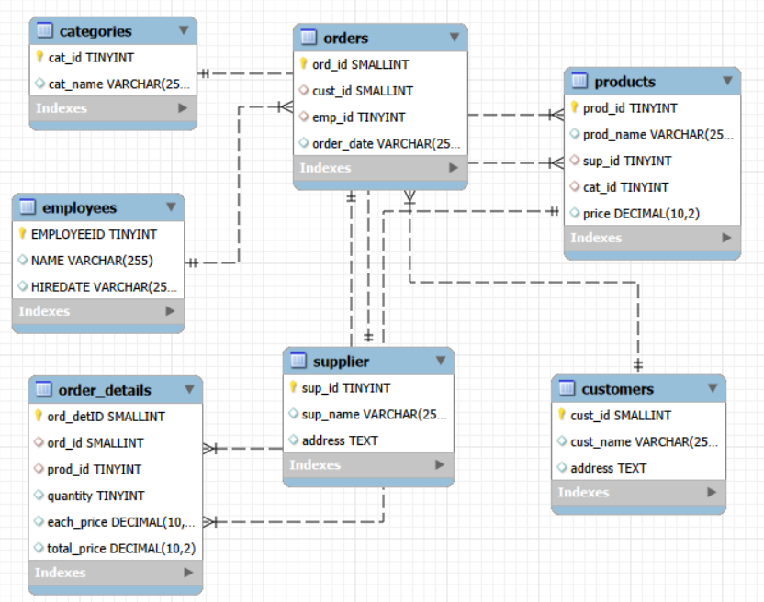
ER Diagram and Schema Explanation
One-to-Many from supplier to products — One supplier provides many products; each product has one supplier.
One-to-Many from categories to products — One category contains many products; each product belongs to one category.
One-to-Many from products to order_details — A product appears in many order details; each detail refers to one product.
One-to-Many from orders to order_details — One order has many details; each detail belongs to one order.
One-to-Many from customers to orders — A customer places many orders; each order belongs to one customer.
One-to-Many from employees to orders — An employee handles many orders; each order is handled by one employee.

Slide 5
Key analysis questions (use cases)
Customer Insights

Slide 6
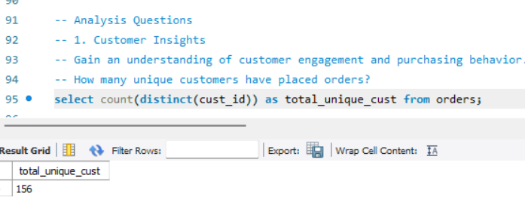
How many unique customers have placed orders?
Measures the number of active customers who made purchases.
Indicates customer engagement and market reach.
Helps evaluate customer retention and acquisition.
Useful for tracking business growth over time.
Supports planning for marketing and loyalty strategies.

Slide 7
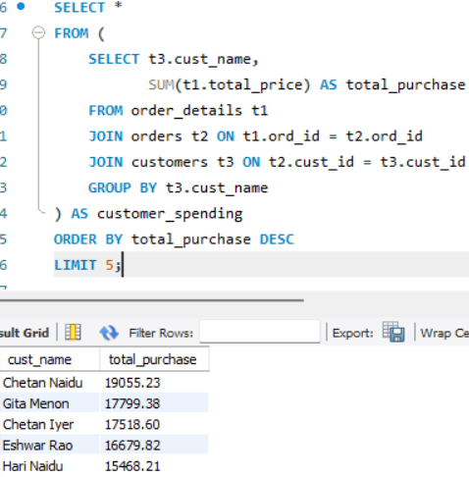
Who are the top 5 customers by total purchase amount?
Identifies the highest-value customers contributing most revenue.
Helps focus on VIP customer retention and personalized offers.
Reveals spending patterns and customer loyalty.
Supports targeted marketing and sales strategies.
Aids in maximizing overall profitability.

Slide 8
Product Performance

Slide 9
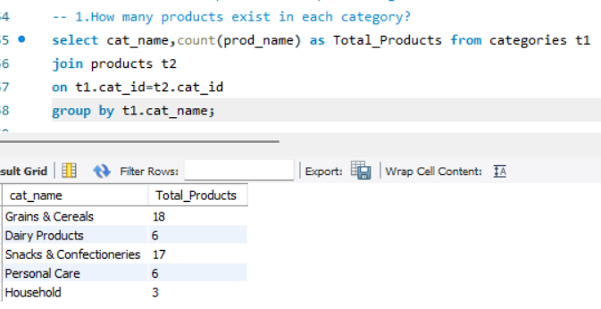
How many products exist in each category?
Counts products per category using aggregation query.
Reveals category distribution of inventory.
Identifies overstocked or underrepresented categories.
Supports inventory planning and product assortment decisions.
Helps track category performance.

Slide 10
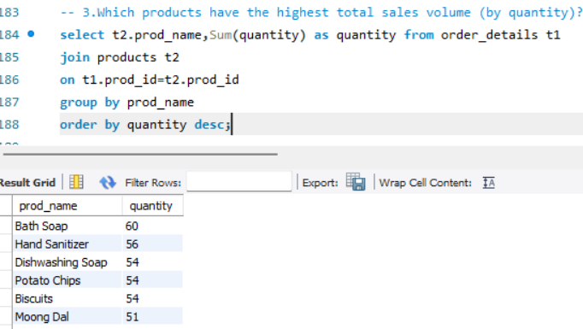
Which products have the highest total sales volume (by quantity)?
Identifies top-selling products by quantity using sales aggregation.
Highlights high demand items.
Helps optimize stock replenishment and inventory levels.
Supports pricing and promotion decisions.
Reveals product popularity trends.

Slide 11
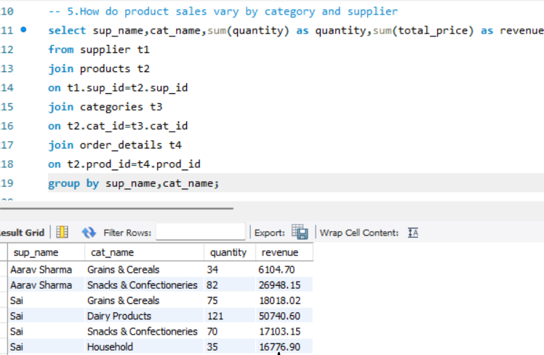
How do product sales vary by category and supplier?
Compares sales performance across categories and suppliers.
Identifies top-performing supplier–category combinations.
Reveals high-revenue and low-revenue segments.
Helps improve supplier management and product mix.
Supports strategic sourcing and inventory planning.

Slide 12
Sales and Order Trends

Slide 13
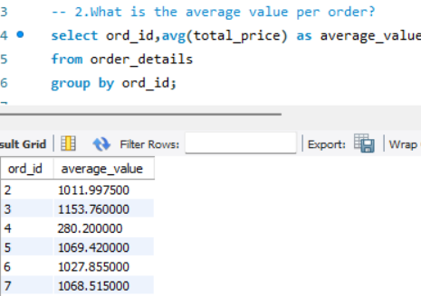
What is the average value per order?
Shows the average order value (AOV) across all orders.
Indicates customer spending behavior per purchase.
Helps evaluate pricing and promotion effectiveness.
Useful for tracking revenue quality and growth trends.
Supports strategies to increase basket size and sales.

Slide 14
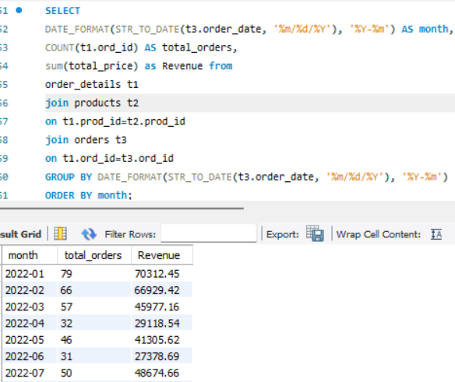
What are the monthly trends in order volume and revenue?
Reveals monthly order volume patterns and revenue fluctuations.
Helps identify peak sales months and slow periods.
Useful for understanding seasonality and demand changes.
Supports inventory planning and staffing decisions.
Guides marketing campaigns to maximize revenue.

Slide 15
Supplier Contribution

Slide 16
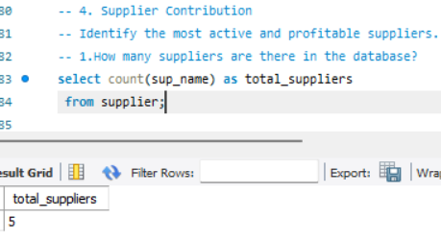
How many suppliers are there in the database?
Shows the total number of suppliers available in the database.
Helps assess supplier diversity and sourcing options.
Useful for evaluating supply chain coverage.
Supports decisions on vendor management and partnerships.
Indicates potential dependency risks if supplier count is low.

Slide 17
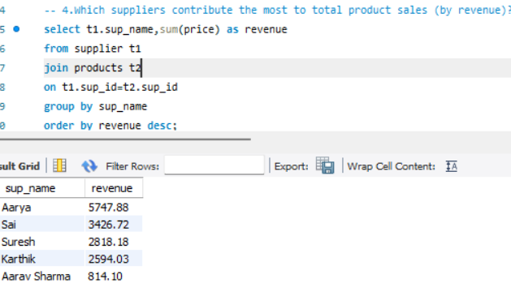
Which suppliers contribute the most to total product sales (by revenue)?
Identifies top suppliers by total revenue contribution.
Helps evaluate supplier performance and profitability.
Useful for strengthening relationships with high-value suppliers.
Supports procurement and negotiation strategies.
Highlights opportunities to optimize sourcing and inventory.

Slide 18
Employee Performance

Slide 19
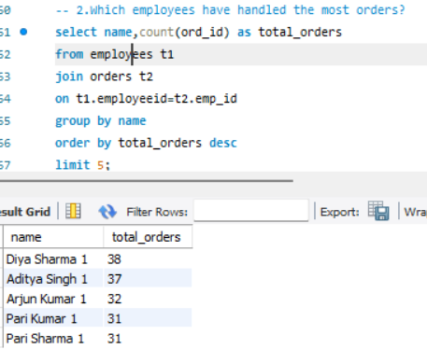
Which employees have handled the most orders?
Identifies top-performing employees by order handling volume.
Helps evaluate workload distribution across staff.
Supports performance reviews and recognition.
Highlights potential training or staffing needs.
Improves overall operational efficiency.

Slide 20
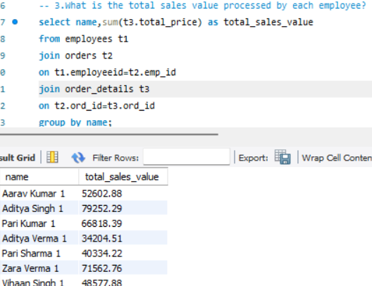
What is the total sales value processed by each employee?
Shows revenue contribution per employee.
Identifies top revenue generators.
Helps assess sales performance and productivity.
Supports incentive and bonus decisions.
Highlights training or support needs for low performers.
Useful for resource planning and workload balance

Slide 21
Order Details Deep Dive

Slide 22
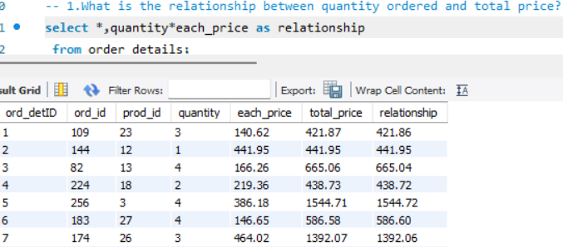
What is the relationship between quantity ordered and total price?
Shows correlation between quantity and total price.
Higher quantity → higher total revenue (generally positive relationship).
Helps identify bulk purchasing patterns.
Useful for pricing strategy and discount analysis.
Reveals high-volume, high-value orders.
Supports sales forecasting and demand planning.

Slide 23
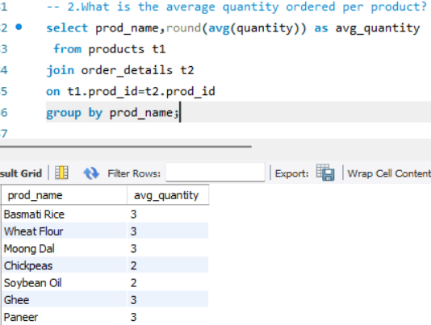
What is the relationship between quantity ordered and total price?
Positive relationship between quantity ordered and total price.
As quantity increases, total order value increases.
Indicates bulk orders contribute more revenue.
Helps detect pricing consistency (unit price stability).
Useful for discount evaluation and sales strategy.
Supports demand and revenue forecasting.

Slide 24
Final business insights and recommendations
Focus on high-value customers through loyalty and retention strategies.
Optimize inventory and product mix based on best-selling and low-performing items.
Strengthen supplier partnerships to improve cost and supply reliability.
Improve employee performance and workload balance using operational insights.
Use sales trends and KPIs for data-driven planning, pricing, and forecasting

Slide 25
Conclusion
Customer insights: Identified top customers and ordering patterns to support retention and targeted strategies.
Product & category performance: Highlighted high-demand products and revenue-driving categories for better inventory decisions.
Supplier impact: Determined which suppliers contribute most to overall sales.
Employee performance: Evaluated order handling and total sales processed by employees to assess efficiency.
Sales trends & profitability: Analyzed monthly trends and quantity-price relationships to support forecasting and data-driven decisions.

Slide 26


Slide 27
Experience/Challenges working on SQL
Gained hands-on experience in designing relational databases and understanding real-world business data.
Improved skills in writing complex SQL queries using joins, aggregations, subqueries, and CTEs.
Faced challenges in maintaining data consistency and correctly linking multiple tables.
Worked through issues like query debugging, handling duplicates, and optimizing results.
Enhanced analytical thinking and confidence in using SQL for data-driven decision making.

Slide 28

THANK YOU

